Slide 1





Missouri Commuter Analysis
Martin Carriel, Addison Pietroburgo, Joshua Steinmetz, Scott Stevener
Washington University Data Analytics Boot Camp
Fall 2018

Slide 2
Motivation & Summary
Our Questions
How do Missourians commute?
What differences exist for commuting types across counties in Missouri?
What differences exist for commuting types within metropolitan areas in Missouri?
Hypotheses
H0 = No differences exist between commuting types in metro versus rural counties across Missouri.
H1 = Differences exist between commuting types in metro versus rural counties across Missouri, where usage of public transit in metro counties is higher.

Slide 3
Questions & Data
What kinds of data were needed?
Missouri-wide commuting data at the county level
Defined Metropolitan Statistical Areas (MSAs) for Missouri
Geocoordinates for each county
Data sources
US Census API
Wikipedia
Wikilou.com
MARC.org (Mid-America Regional Council)
Google Maps Geocode API

Slide 4
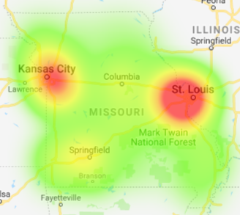
Data Exploration & Cleanup
Used census wrapper to make API calls to get commuter data for each county in MO
Calculated commuter type %s
Made calls to the Google Maps Geocode API to get coordinates for each county
Created heat map of commuter concentrations
Looked up counties in STL, KC and Springfield MSAs and repeated process for counties outside of MO

Slide 5
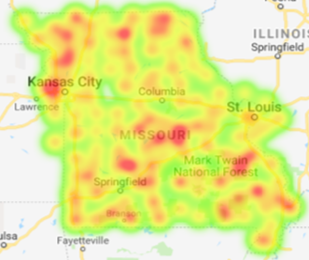
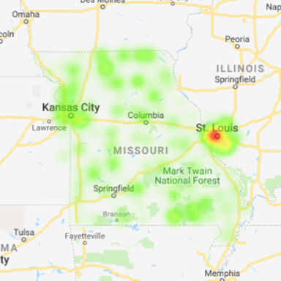
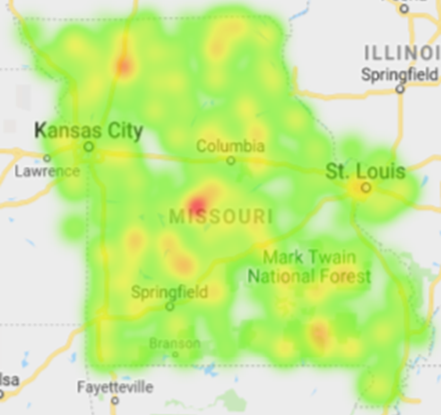
Data Analysis: Commute Type Concentrations in MO
Carpooler %
(max. 19%)
- Kansas City
- Jefferson City
- Farmington
Public Transit %
(max. 10%)
- St. Louis
Other Transit %
(max. 5%)
- Ozarks

Slide 6
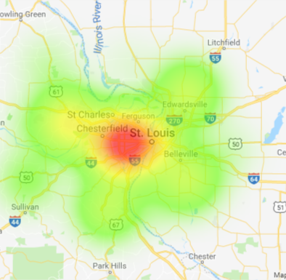
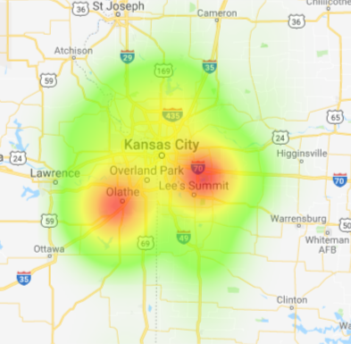
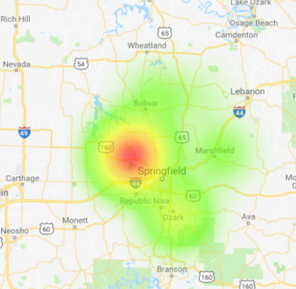
Data Analysis: MSA Comparisons - Commuter Concentrations

Slide 7
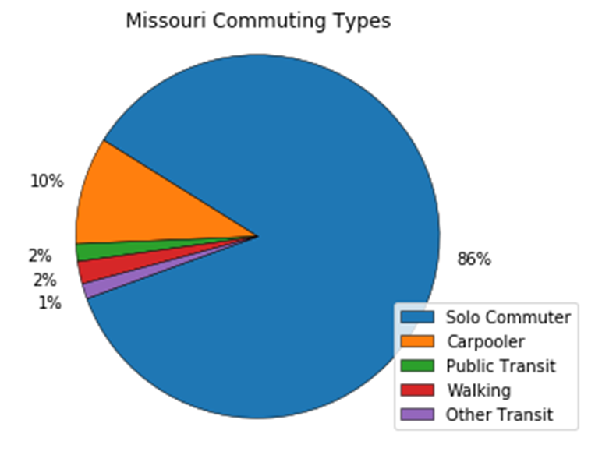
Data Analysis: Statewide
As expected, a massive majority of Missouri commuters are “Solo Commuters”
Commuter proportions very similar county to county. Highest numbers of commuters located in Kansas City, St. Louis and along I-44.
A very small amount of commuters represented who use public transit, walk or are listed as using “other transit”.
We love our cars!

Slide 8
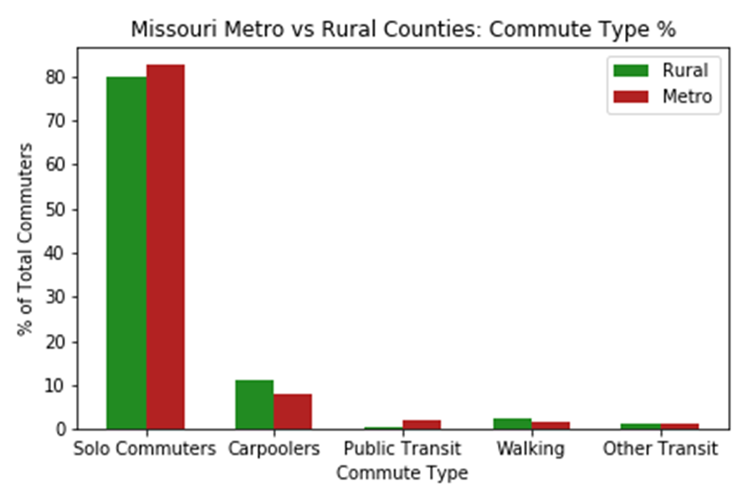
Data Analysis: Urban vs. Rural
Not a very significant level of difference.
By conducting an Independent T-Test it was found that rural areas do have a decently higher amount of carpoolers and walking commuters.
This could be due to people living in closer proximity to their place of work in rural areas.

Slide 9
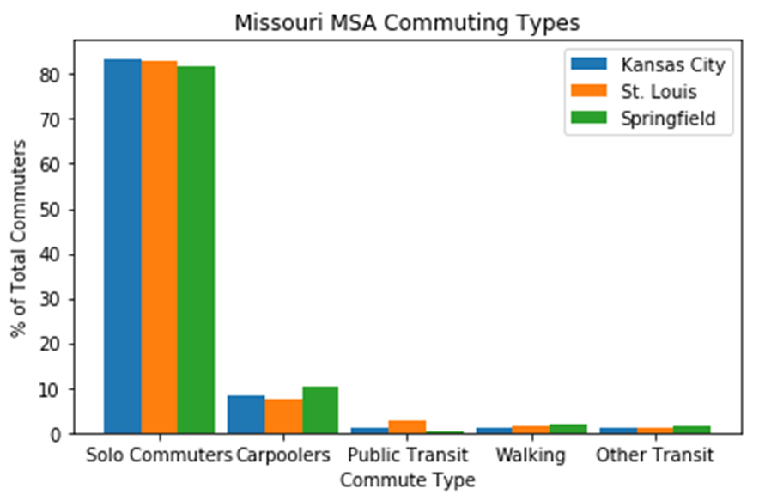
Data Analysis: Metro vs. Metro
An ANOVA test revealed significant differences for commute types % between the cities.
A T-Test showed Carpooler % between Kansas City and St. Louis to be significant
Visually notable differences include amount of carpoolers and amount of walking commuters in Springfield.
Could be due to higher percentage of people living near their place of work (i.e. a college campus, manufacturing facility, medical complex).

Slide 10
Discussion
Results were surprising, but not unexpected
We expected
More significant differences between urban/rural commuting types
A difference in commuting types between metro areas
That public transit was used more
Inferences or general conclusions
Driving to work alone is considered the best commuting option.
Commuting options other than solo driving are limited statewide.
Public transit options exist almost exclusively in urban areas.
Even where available, public transit is not significantly used.

Slide 11
Post-Mortem
Difficulties during analysis
Defining metropolitan areas for analysis
Metro areas in Missouri range from nearly 3 million in population (St Louis) to around 150,000 (Columbia).
We chose to classify the three most densely populated areas “metro” or urban and all remaining counties as “rural”
How to deal with small numbers of counties when running ANOVA and T-Tests
Given additional time further analysis would include:
Time of commute across commuting types
Distance of commute across commuting types

Slide 12
Post-Mortem
Other data that could offer relevant information include:
Average commute type across urban and rural regions including age, education, and income data
We found that rural and urban regions of Missouri did not differ dramatically in commuting behavior.
Expanding this study to include additional states and regions of different sizes could provide different results

Slide 13
Questions?

